Slide 1
Course Expectations - Embedded systems
Dr. Sreejith Rajan

Slide 2
Type of Contents
Pre - Recorded Videos
Live Session
Live Recordings
PDF Contents

Slide 3
Course Outcomes
Solid Foundations in Embedded Systems
Hands-On Hardware and Software Skills
Intermediate to Advanced Embedded Development
IoT Integration
Embedded Linux and Device Driver Development
Career-Readiness and Industry Skills

Slide 4
Time Management & Weekly Learning Expectations
Weekly Expectations:
Consume weekly content on a regular weekly basis to stay on track.
Watch prerequisite content before attending the live sessions.
Attend live classes to gain deeper insights, clarify doubts and engage with faculty

Slide 5
Time Management & Weekly Learning Expectations
Why Consistency Matters:
Regular learning builds strong foundational knowledge.
Staying consistent reduces last-minute pressure and improves retention.

Slide 6
Live Class Expectations & Importance
Live sessions focus on practical tutoring of key concepts, enabling you to apply what you’ve learned effectively.
Gain deeper insights through real-time discussions, problem-solving, and direct faculty guidance.
75% attendance in live classes is mandatory to fulfill course completion requirements.
If you miss a live session, you must watch the live recording within the same week to stay aligned with the course schedule and assignments.
Active participation enhances understanding and improves long-term retention of concepts.

Slide 7
Assignments & Live Projects
Assignments
Designed to reinforce learning and assess your understanding.
Must be completed and submitted within the due date using the submission section in the app.
Timely submission is important for tracking progress and course completion.
Live Projects
Real-world, application-based projects to help you gain hands-on experience.
Involve applying concepts learned throughout the course.
Active participation is mandatory for practical exposure and final evaluation.

Slide 8
Course Overview
Number of Modules: 9
Number of Technical sessions: 96 Hours
HR and CV sessions: 4 Hours
Classes will be on alternate days (MWF/TTS)
Number of assignments: 18
Capstone Project: 1
Number of certificates : 3
Course duration – 8 months
CV or Assignment evaluation lead time: 15 working days

Slide 9

Our official Communication Channel
Slack
Ask the queries in Group and Live Sessions

Slide 10
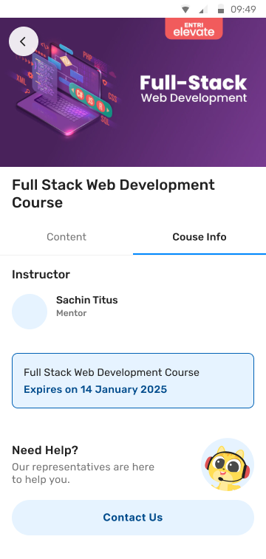
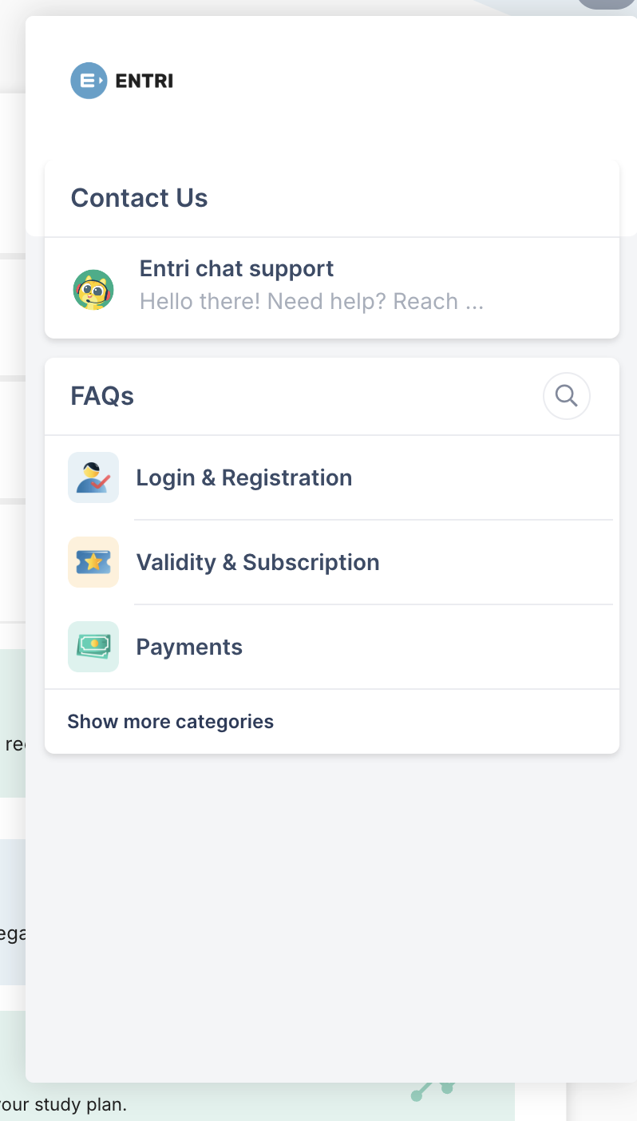
In the application:
Contact Us
Contact us in this number:
OR
9446549626
Mobile device
Desktop/Laptop

Slide 11
“Being a student is easy. Learning requires actual work.”
- William Crawford
Thank you

